Slide 1
TRAFFIC LIGHT USING IC741
AUTOMATIC STREET LIGHT BY SHRUTI BAYA
ECE-2ND YEAR MNIT JAIPUR

Slide 2
Components Required
Operational Amplifier IC 741
12V SPDT Relay
LDR
Transistor BC547 NPN
Diode 1N4001
Variable Resistor 10KΩ
Resistor (R3, R6) 1KΩ = 2
Resistor 100KΩ = 2
Resistor 470Ω

Slide 3
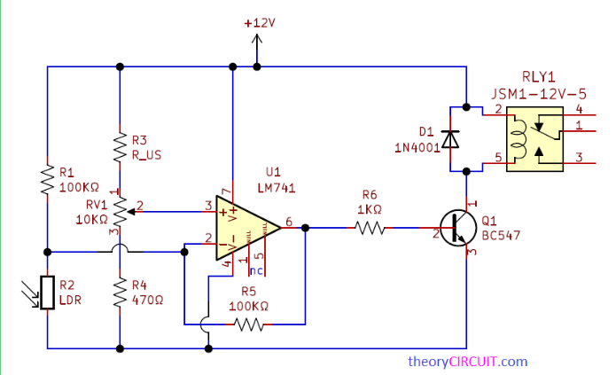
CIRCUIT DIAGRAM

Slide 4
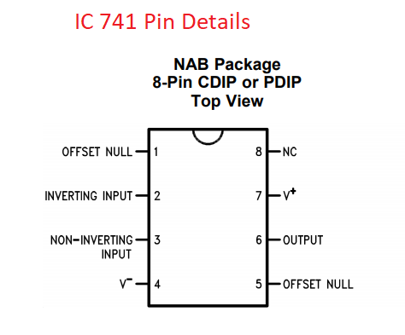
PIN DIAGRAM OF IC 741

Slide 5
Construction & Working
Purpose of this Automatic Street Light circuit is to turn ON light bulb during night time and turn OFF during day time. Hence we used LDR as a light/dark sensing device (Place the sensor above or behind light source, that is LDR should sense natural light only).
Output terminal from operational amplifier is connected with base terminal of transistor BC547, 12 volt SPDT Relay coil is connected between +12V and transistor Q1 Collector terminal. Variable Resistor RV1 gives the Sensitivity level to Non Inverting input of IC 741. Feedback Resistor connected between Output pin and Inverting Pin.

Slide 6
When there is natural light then the LDR Resistance level goes down so that voltage and current flow through R1 easily goes to the ground or negative. Hence the inverting input receives low range voltage and current due to that Output voltage decrease and turns OFF the transistor. So the Relay coil gets disconnected from bias and turns OFF the light source connected with the common and N/O pins.
LDR Resistance level increase due to darkness after sunset. Hence the maximum voltage and current flow through R1 Reaches inverting input of Op-Amp, So the output voltage also gets increase and turns ON the transistor Q1 by the way Relay coil gets bias and turns ON the light Source connected with the common and N/O pins.

